Slide 1
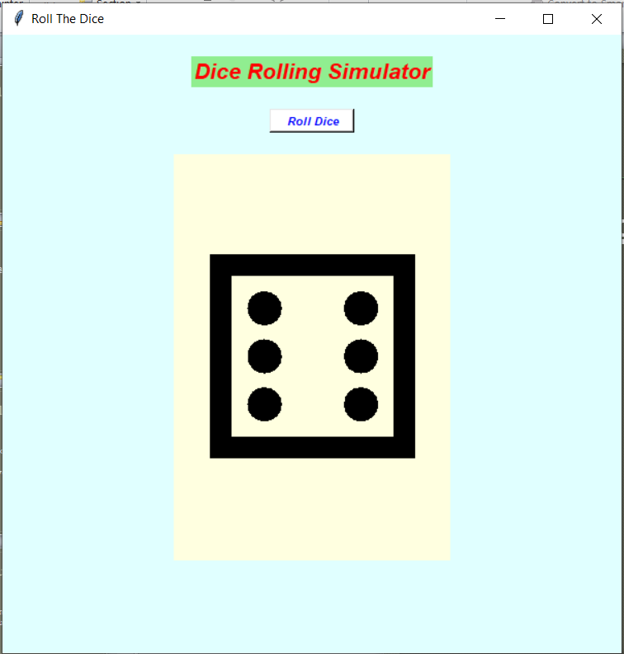
Dice Rolling Simulator

Slide 2
What is Simulator???
A simulation is a program or machine that simulates a real life situation, meaning that it creates a virtual version of it.

Slide 3
Types of simulator.
Live Simulation
Virtual Simulation
Constructive Simulation

Slide 4
Live Simulation
This simulation involving real people operating real systems.

Slide 5
Virtual Simulation
This simulation involving real people operating simulated systems.
This inject Human-In-The-Loop in a central role by exercising.

Slide 6
Constructive Simulation
Real people can simulate(make inputs) but are not involved in determining outcomes.

Slide 7
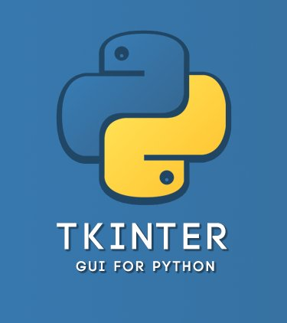

GUI (Graphic User Interface)
Tkinter is the most common, fast and easy to use Python package to build GUI application.To install the library, you can use pip install command to the command prompt:

Slide 8
Geometric Manager
There are mainly three geometery manager classes class.
Pack() method
Grid() method
Place() method

Slide 9
Widgets in Tkinter
Button
Canvas
Check Button
Entry
Frame
Label
List Box

Slide 10

Random Module
It is used to generate the pseudo-random variables.
To use random module
we have to import first the module into our file.

Slide 11
Methods in Random Module
Randrange()
Randint()
Random()
Uniform()
Choice()
Shuffle()

Slide 12
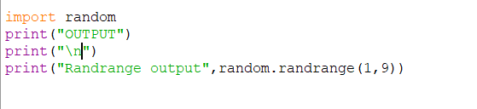
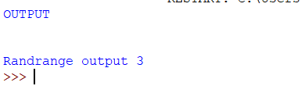
Randrange()
Always returns an
integer value which
include
the lower limit and
exclude the upper
limit.

Slide 13
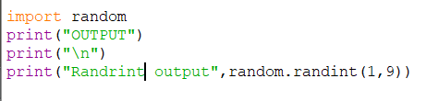
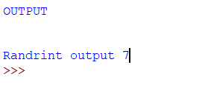
Randint()
Always returns an
integer value which
includes
both lower limit and
the upper limit.

Slide 14
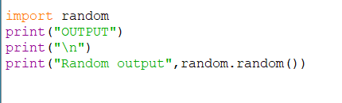
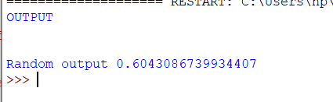
Random()
Always returns
floating value
between 0 and 1.
no parameters
requires for this
method.

Slide 15
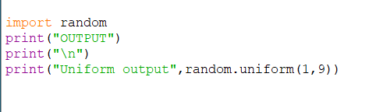
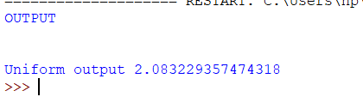
Uniform()
Always returns
floating value
which include
the lower limit and
exclude the upper
limit.

Slide 16
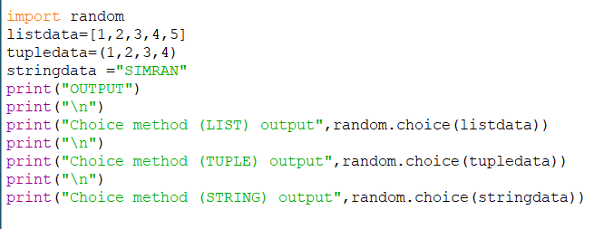
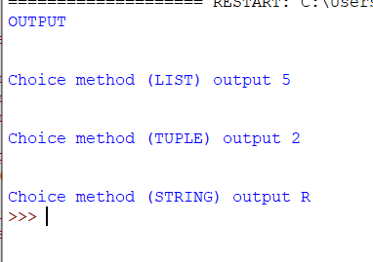
Choice()
This method is
used for random
selection from
list,tuple,string.

Slide 17
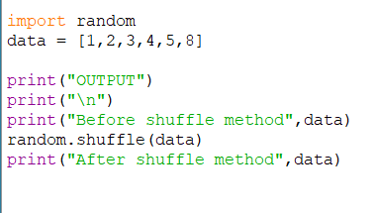
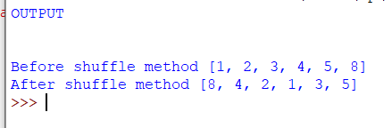
Shuffle()
This method shuffle
the items of a
given list.
(change the order
of the list item)

Slide 18
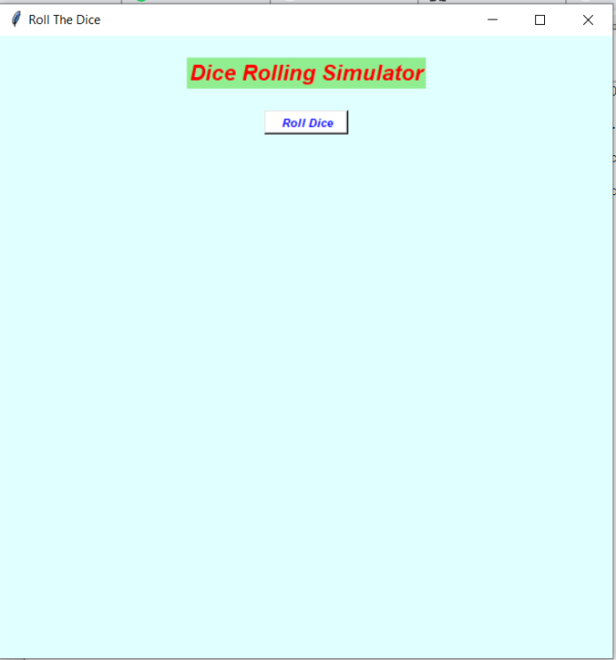
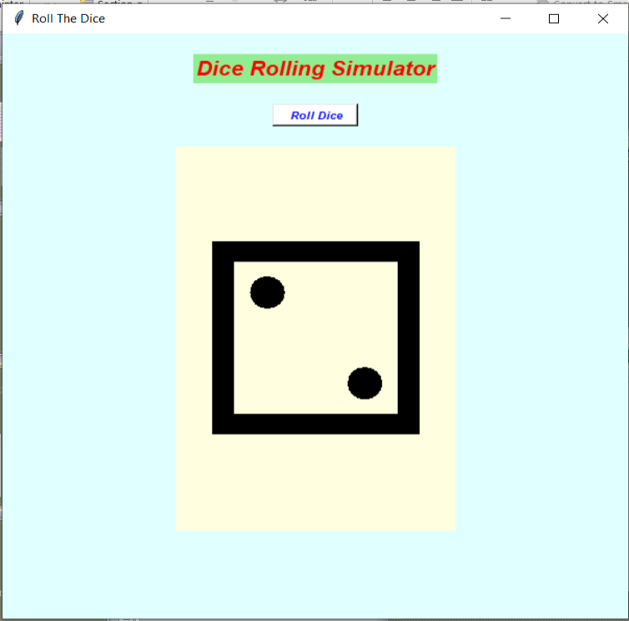
Working of simulator
Initial stage
Functional stage

Slide 19
Thankyou…

